Slide 1
Used Vehicle Market Research Within the U.S.
ALY 6040 Data Mining Applications
Professor Justin Grosz
Group Member: Yujia Fu, Yijin Liu, Ziqing, Shen, Liuzhao Tang

Slide 2

Project Introduce
The United States is the largest used car market
The used car market is developing in an orderly manner, with a complete system, and is generally recognized by consumers
As a consumer, what is the most cost-effective choice when buying a used car
As an operator of a used car company, how to maximize benefits

Slide 3

Project Goal
Find out factors that could possibly impact the price of the vehicles in the used car market
Indicate factors that could help stakeholders
Make suggestions to stakeholders

Slide 4
Data - Resource
Kaggle: Used Cars Dataset
13 rows and 10001 columns
variables we used: Price, Year, Manufacture, Fuel, odometer, title status, type, paint color

Slide 5
Data - Cleansing
Missing value: Mode
Outliers: mean ± 2* standard deviation
Variable: Classification
67 dummy variables
6 dummy variables

Slide 6
Variable derivement example: Manufacturer
Original
40+ unique values
1th-classification
7 dummy variables
2nd-classification
2 dummy variables
Ford
Toyota
Mini
Volkswagen
...
US
JP
UK
DE
IT
KR
SE
America
Asia

Slide 7
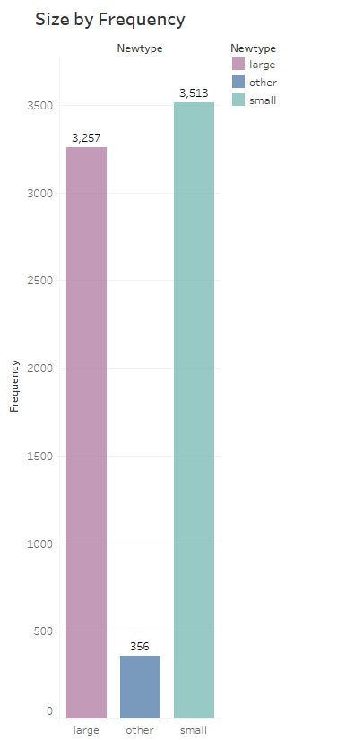
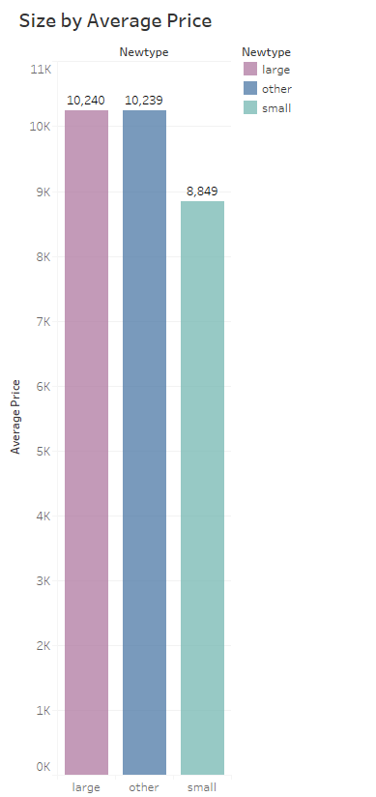
EDA - Size

Slide 8
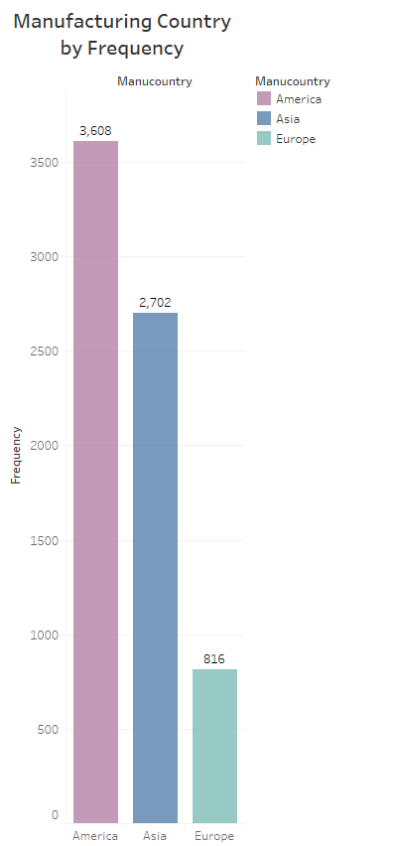
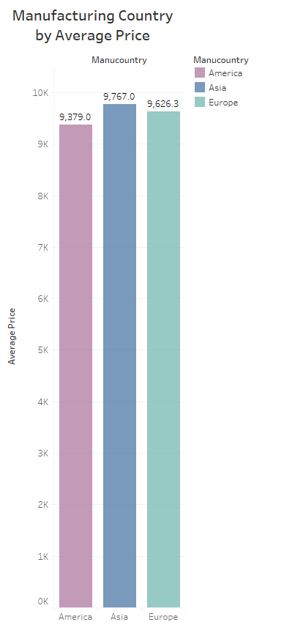
EDA - Manufacturing Country

Slide 9
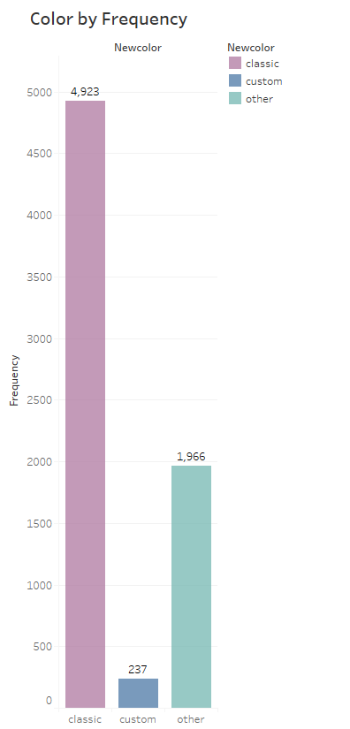
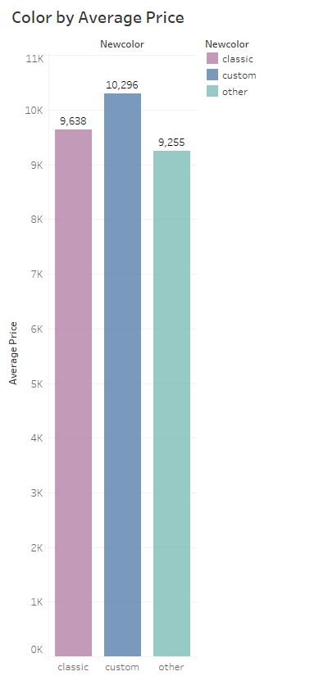
EDA - Color

Slide 10
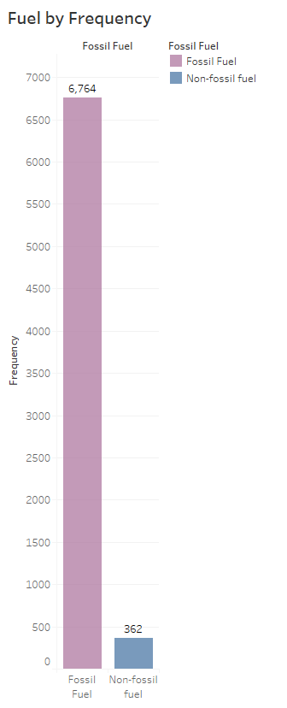
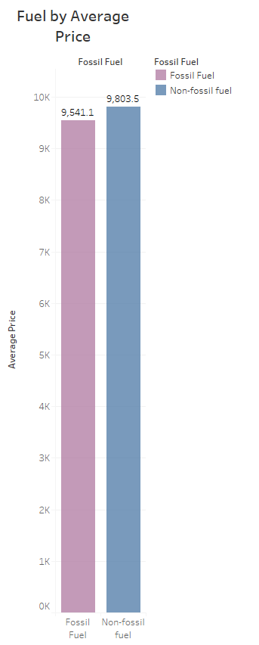
EDA - Fuel

Slide 11
Model and result
pre-preparation
Build first model
Check model result
Build optimize model
Split data set
Determine optimize methods
Confirm results
Calculate MSE
Choose the best model

Slide 12
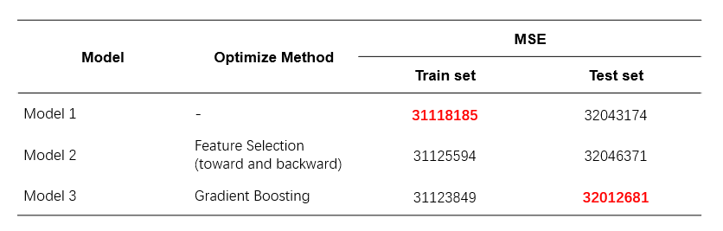
Model and result
More detail see: Data visualization dashboard

Slide 13
conclusion
The model should be optimized before business forecasting
The most popular type of vehicles have the following features: small size, classic colors (black, white, grey and silver), clean title, U.S. made, and gas as the fuel type.
The differences in automobile features could lead to different prices in the used car market.

Slide 14
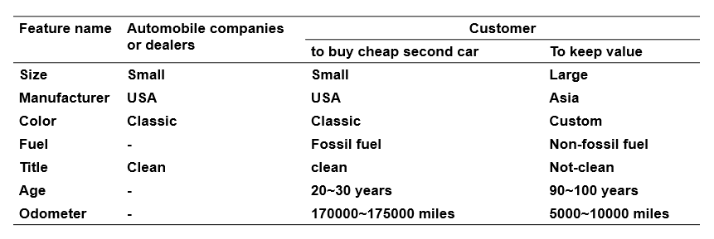
Call Action
For automobile companies and dealers: emphasize these most popular features in future designs and showings
For customers: flexibly decide the features when buying a vehicle

Slide 15

Q&A

Slide 16
THANK YOU

